Slide 1
CSM104: Analog and Digital Electronics
YEAR 1
LECTURER: Dr. Alfred UWITONZE
CONTACTS: Phone number: 0788549588
E-mail: alfruwitonze@gmail.com
Academic Year 2022-2023

Slide 2
GRADING
CAT 1 (3 Assignements): 30%
CAT 2: 30%
FAT: 40%

Slide 3
UNIT 2: ANALOG ELECTRONICS
Analog electronics is a branch of electronics that deals with the continuous electrical signals, rather than the discrete or digital signals used in digital electronics.
Analog circuits are used to process and transmit information using continuous signals that can vary in voltage or current over time.
Some common examples of analog electronic devices include amplifiers, filters, oscillators, and sensors.
These devices are often used in a wide range of applications, including audio and video equipment, telecommunications systems, and control systems.

Slide 4
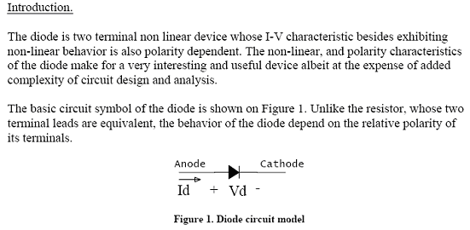
UNIT 2: ANALOG ELECTRONICS
Diodes

Slide 5
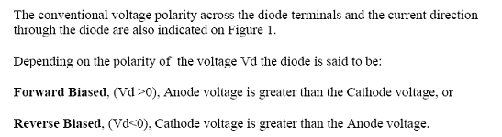
UNIT 2: ANALOG ELECTRONICS
Diodes

Slide 6
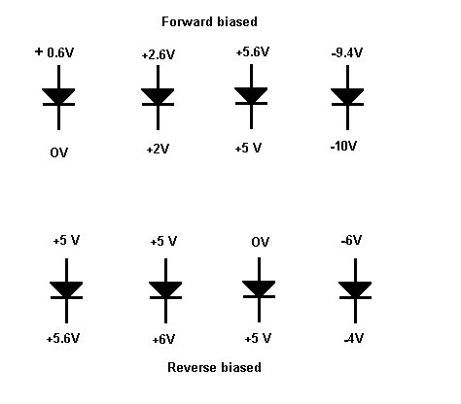
UNIT 2: ANALOG ELECTRONICS
Diodes

Slide 7
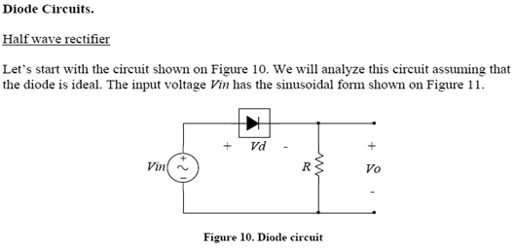
UNIT 2: ANALOG ELECTRONICS
Diodes

Slide 8
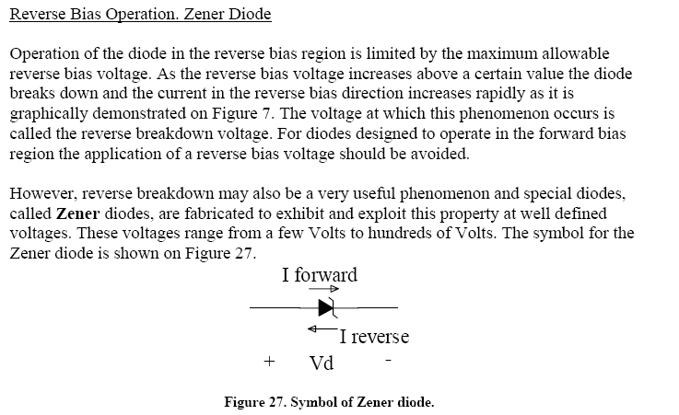
UNIT 2: ANALOG ELECTRONICS
Diodes

Slide 9
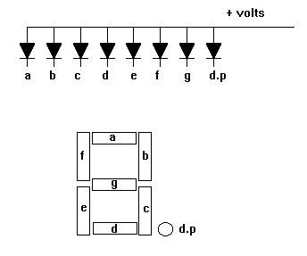
UNIT 2: ANALOG ELECTRONICS
Diodes
7 Segments Display

Slide 10
UNIT 2: ANALOG ELECTRONICS
Diodes
7 Segments Display
The 7-segment display is used as a numerical indicator on many types of test equipment.
It is an assembly of light emitting diodes which can be powered individually.
They most commonly emit red light. They are arranged and labelled as shown in the diagram.
Powering all the segments will display the number 8. Powering a,b,c d and g will display the number 3. Numbers 0 to 9 can be displayed.
The d.p represents a decimal point.

Slide 11
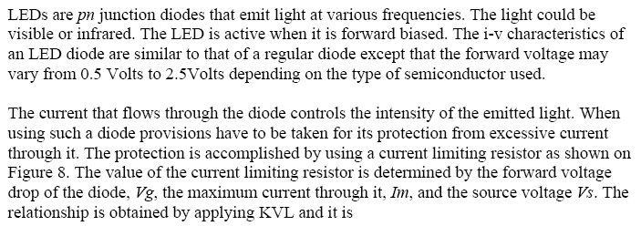
UNIT 2: ANALOG ELECTRONICS
Diodes
Light Emitting Diode (LED)

Slide 12
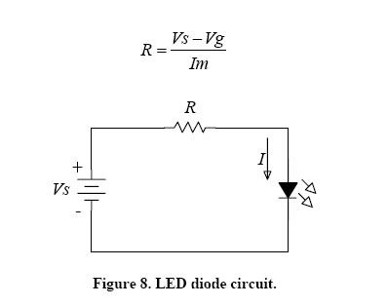
UNIT 2: ANALOG ELECTRONICS
Diodes
Light Emitting Diode (LED)

Slide 13
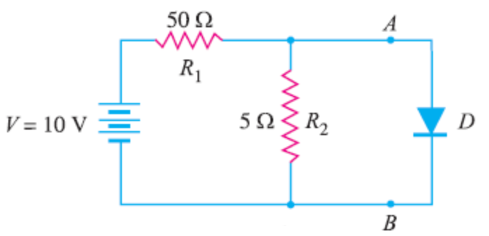
UNIT 2: ANALOG ELECTRONICS
Exercises on Diodes
1. Find the current through the diode in the circuit shown in Figure below. Assume the diode to be ideal.

Slide 14
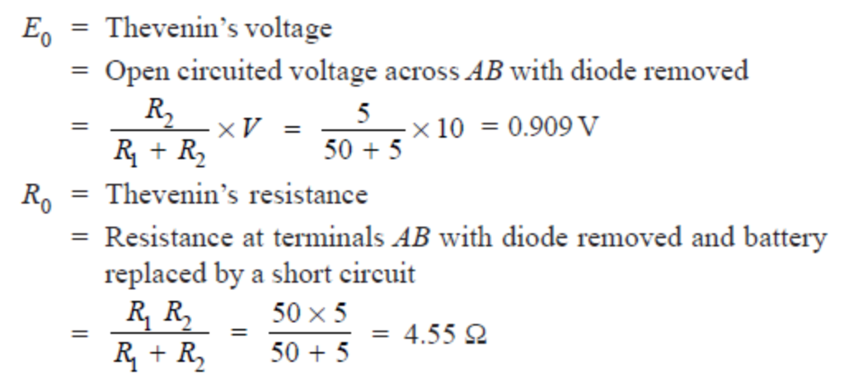
UNIT 2: ANALOG ELECTRONICS
Exercises on Diodes
Solution:
We shall use Thevenin’s theorem to find current in the diode.

Slide 15
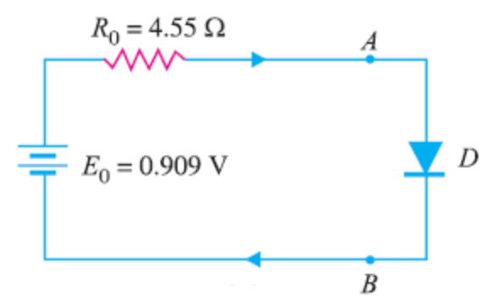
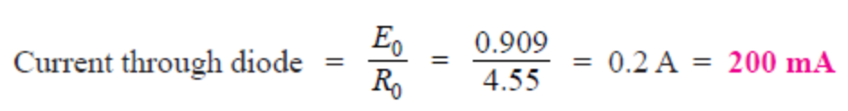
UNIT 2: ANALOG ELECTRONICS
Exercises on Diodes
Solution:
The Figure below shows Thevenin’s equivalent circuit. Since the diode is ideal, it has zero resistance.

Slide 16
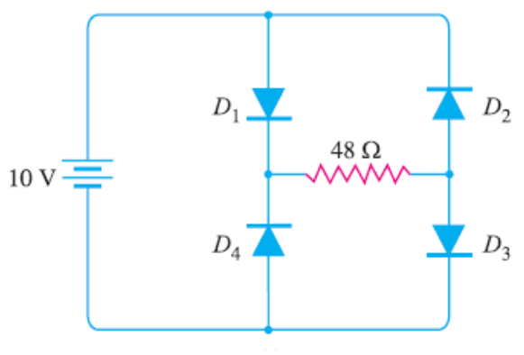
UNIT 2: ANALOG ELECTRONICS
Exercises on Diodes
2. Calculate the current through 48 Ω resistor in the circuit shown in Figure below. Assume the diodes to be of silicon and forward resistance of each diode is 1 Ω.

Slide 17
UNIT 2: ANALOG ELECTRONICS
Exercises on Diodes
Solution:
Diodes D1 and D3 are forward biased while diodes D2 and D4 are reverse biased. We can, therefore, consider the branches containing diodes D2 and D4 as “open”.
Replacing diodes D1 and D3 by their equivalent circuits and making the branches containing diodes D2 and D4 open, we get the circuit shown in Figure. As we know for a silicon diode, the barrier voltage is 0.7 V, while a Germanium diode has a barrier voltage of 0.3 V.

Slide 18
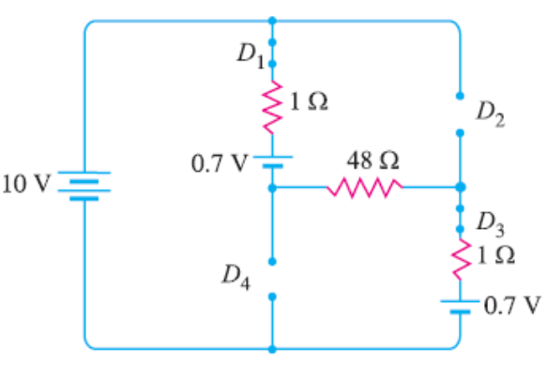
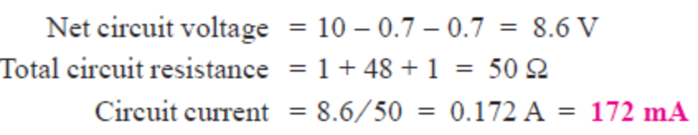
UNIT 2: ANALOG ELECTRONICS
Exercises on Diodes
Solution:

Slide 19
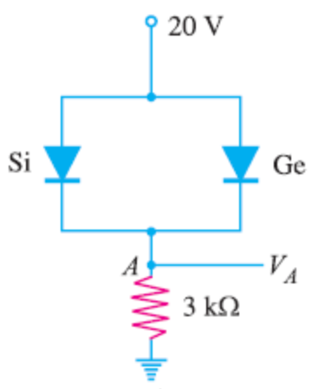
UNIT 2: ANALOG ELECTRONICS
Exercises on Diodes
3. Find the voltage VA in the circuit shown in Figure below. Use simplified model.

Slide 20
UNIT 2: ANALOG ELECTRONICS
Exercises on Diodes
Solution:
It appears that when the applied voltage is switched on, both the diodes will turn “on”. But that is not so. When voltage is applied, germanium diode (V0 = 0.3 V) will turn on first and a level of 0.3V is maintained across the parallel circuit.
The silicon diode never gets the opportunity to have 0.7 V across it and, therefore, remains in open-circuit state as shown in Figure below:

Slide 21
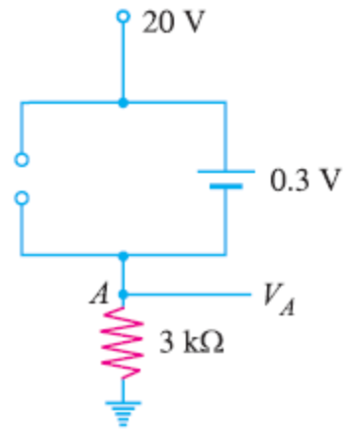

UNIT 2: ANALOG ELECTRONICS
Exercises on Diodes
Solution:

Slide 22
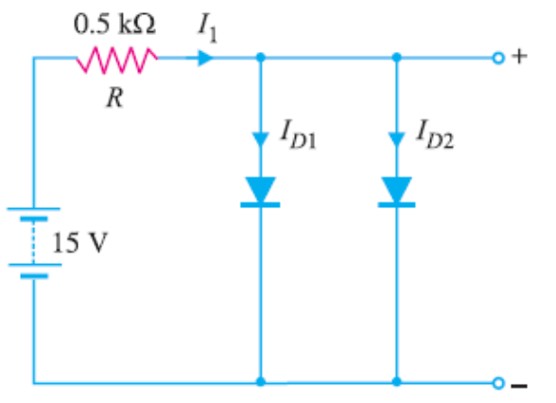
UNIT 2: ANALOG ELECTRONICS
Exercises on Diodes
4. Determine current through each diode in the circuit shown in Figure below. Use simplified model. Assume diodes to be similar (both are Silicon diodes).

Slide 23
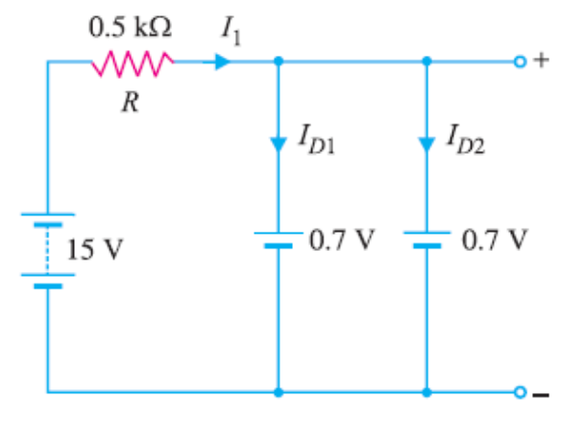
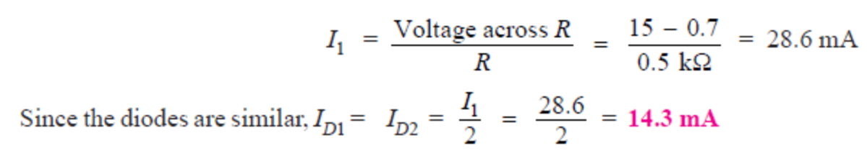
UNIT 2: ANALOG ELECTRONICS
Exercises on Diodes
Solution:
The applied voltage forward biases each diode so that they conduct current in the same direction. Figure below shows the equivalent circuit using simplified model.

Slide 24
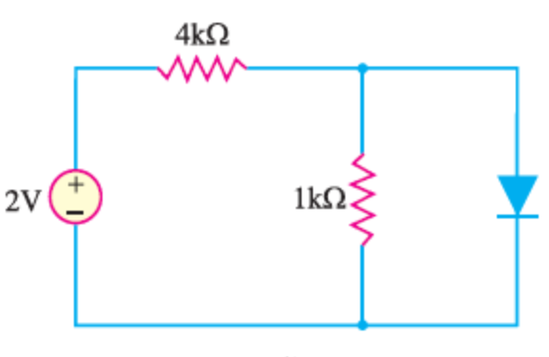
UNIT 2: ANALOG ELECTRONICS
Exercises on Diodes
5. Determine the state of diode for the circuit shown in Figure below and find ID and VD . Assume simplified model for the diode.

Slide 25
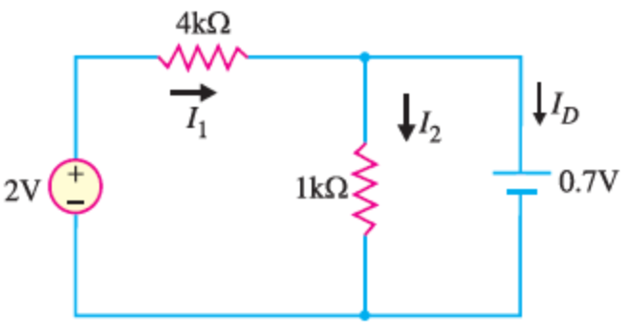
UNIT 2: ANALOG ELECTRONICS
Exercises on Diodes
Solution:
Let us assume that the diode is ON. Therefore, we can replace the diode with a 0.7V battery as shown in the given circuit’s figure. Referring to the simplified model shown below, we have:

Slide 26
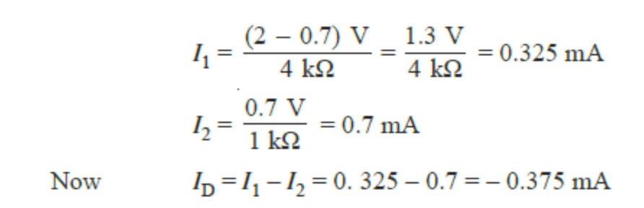
UNIT 2: ANALOG ELECTRONICS
Exercises on Diodes
Solution:
Since the diode current is negative, the diode must be OFF and the true value of diode current is ID =0 mA. Hence our initial assumption was wrong.

Slide 27
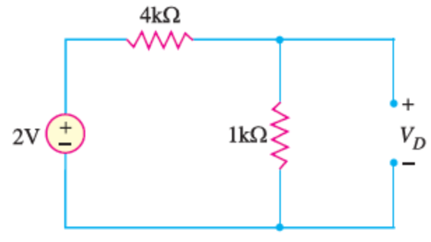
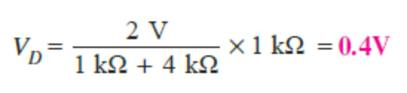
UNIT 2: ANALOG ELECTRONICS
Exercises on Diodes
Solution:
In order to analyse the circuit properly, we should replace the diode in the given circuit’s figure with an open circuit as shown in Figure below:
The voltage VD across the diode is:
We know that 0.7V is required to turn ON the diode. Since VD is only 0.4V, the answer confirms that the diode is OFF.

Slide 28
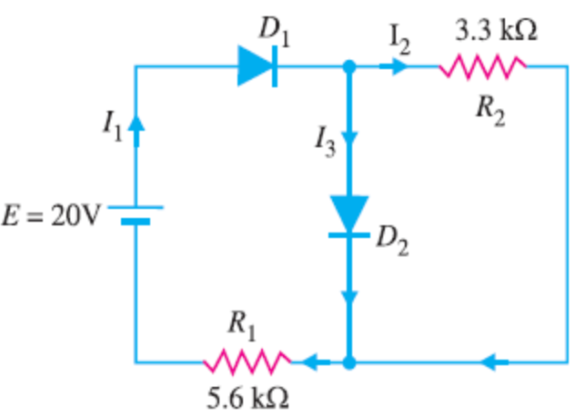
UNIT 2: ANALOG ELECTRONICS
Exercises on Diodes
6. Determine the currents I₁, I₂ and I₃ for the network shown in Figure below. Use simplified model for the diodes and assume both diodes are made from Silicon.

Slide 29
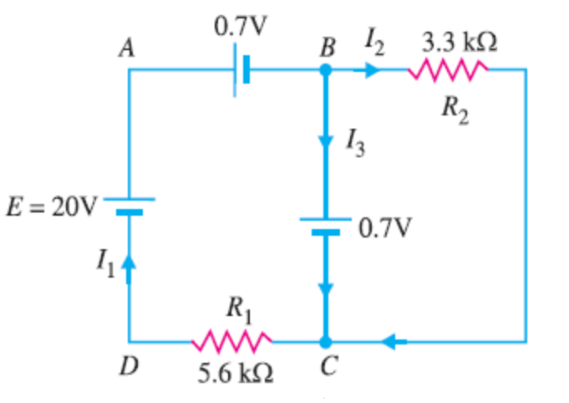
UNIT 2: ANALOG ELECTRONICS
Exercises on Diodes
Solution:
As we can see in Figure for the given circuit, both diodes D1 and D2 are forward biased. Using simplified model for the diodes, the given circuit becomes the one shown in Figure below:

Slide 30
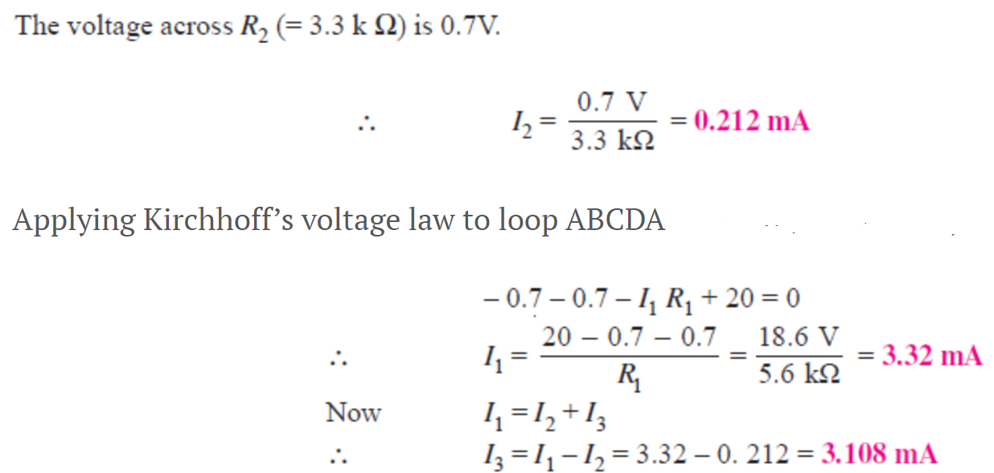
UNIT 2: ANALOG ELECTRONICS
Exercises on Diodes
Solution:

